Slide 1
Bad
Data
(no cookie)
Matthias Shapiro
@politicalmath
http://politicalmathblog.com

Slide 2
Obama Jobs Speech

Slide 3
Obama Jobs Speech
“Our businesses have gone back to basics and created over 4 million jobs in the last 27 months - more private sector jobs than were created during the entire seven years before this crisis in a little over two years.”

Slide 4
Obama Jobs Speech
Last 27 months
4,126,000
private sector jobs
7 years before crisis
3,843,000
private sector jobs

Slide 5
Obama Jobs Speech
“Our businesses have gone back to basics and created over 4 million jobs in the last 27 months - more private sector jobs than were created during the entire seven years before this crisis in a little over two years.”

Slide 6
Obama Jobs Speech
“Our businesses have gone back to basics and created over 4 million jobs in the last 27 months - more private sector jobs than were created during the entire seven years before this crisis in a little over two years.”

Slide 7
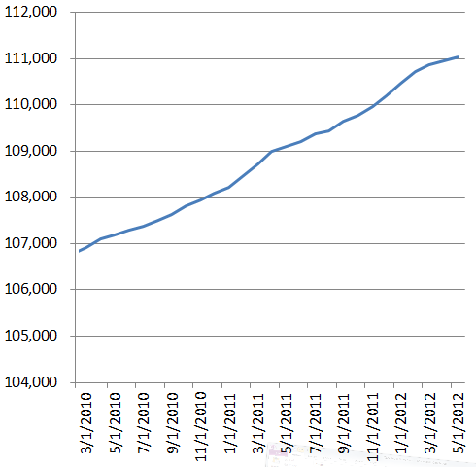
Obama Jobs Speech
4,126,000 private sector jobs

Slide 8
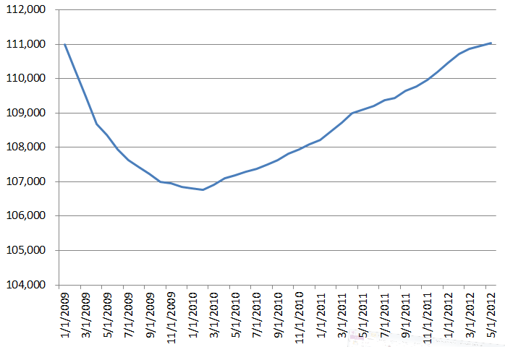
Obama Jobs Speech
55,000 private sector jobs

Slide 9
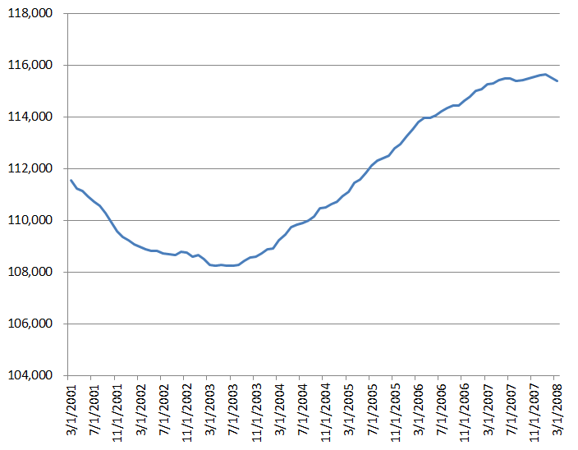
Obama Jobs Speech
“the 7 years before the crisis”
3,843,000 private sector jobs

Slide 10
Obama Jobs Speech
“the 6 years before the crisis”
6,409,000 private sector jobs

Slide 11
Obama Jobs Speech
“the 5 years before the crisis”
7,111,000 private sector jobs
Notes:
In this world we inhabit we have data coming out of our ears. Data collected by the gigabyte, often for no other reason than that we feel it will be useful later on so we might as well have it around. Most of the data we have looks something like this and is contained in databases or data files. This particular data set is a list of coffee drinks available at Starbucks along with how many calories how much caffeine they contain. In this format the data is useful but hard to understand, especially for the layman.

Slide 12
Obama Jobs Speech
“27 months after the previous crisis”
4,531,000 private sector jobs
Notes:
In this world we inhabit we have data coming out of our ears. Data collected by the gigabyte, often for no other reason than that we feel it will be useful later on so we might as well have it around. Most of the data we have looks something like this and is contained in databases or data files. This particular data set is a list of coffee drinks available at Starbucks along with how many calories how much caffeine they contain. In this format the data is useful but hard to understand, especially for the layman.

Slide 13
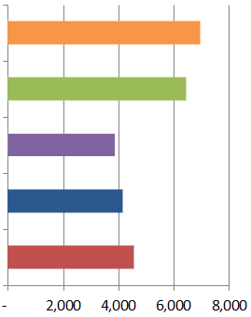
Obama Jobs Speech
5 years
6 years
7 years
27 after jobs low point (Obama)
27 after jobs low point (Bush)

Slide 14
Obama Jobs Speech
5 years
the only “clean” time period that gives fewer jobs
6 years
7 years
27 after jobs low point (Obama)
27 after jobs low point (Bush)
Notes:
In this world we inhabit we have data coming out of our ears. Data collected by the gigabyte, often for no other reason than that we feel it will be useful later on so we might as well have it around. Most of the data we have looks something like this and is contained in databases or data files. This particular data set is a list of coffee drinks available at Starbucks along with how many calories how much caffeine they contain. In this format the data is useful but hard to understand, especially for the layman.

Slide 15
Obama Jobs Speech
count job losses for thee
don’t count job losses for me

Slide 16
Obama Jobs Speech
“private sector jobs”

Slide 17
Obama Jobs Speech
“private sector jobs”
“private sector payrolls”

Slide 18
Obama Jobs Speech
“private sector payrolls”
BLS jobs data
A Tables
(Employment)
B Tables
(Payrolls)
all payrolls
+
self employment
very small business
all payrolls

Slide 19
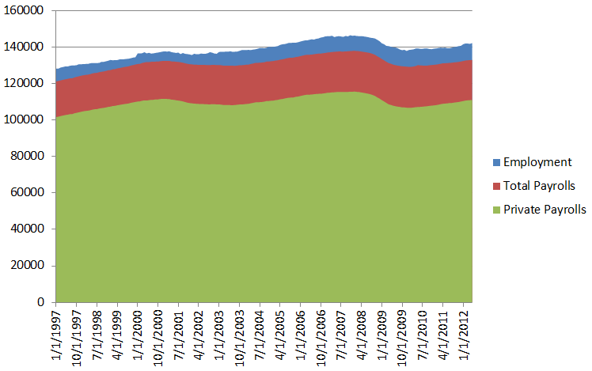
Obama Jobs Speech
“private sector payrolls”
BLS jobs data

Slide 20
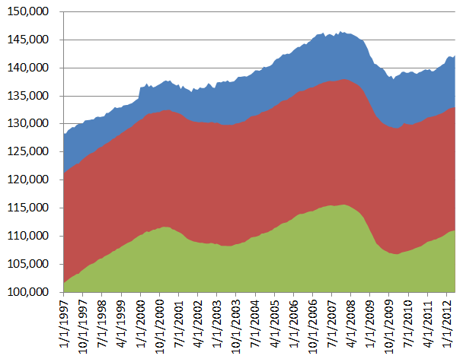
Obama Jobs Speech
“private sector payrolls”
BLS jobs data
Notes:
In this world we inhabit we have data coming out of our ears. Data collected by the gigabyte, often for no other reason than that we feel it will be useful later on so we might as well have it around. Most of the data we have looks something like this and is contained in databases or data files. This particular data set is a list of coffee drinks available at Starbucks along with how many calories how much caffeine they contain. In this format the data is useful but hard to understand, especially for the layman.

Slide 21
THE POINT

Slide 22
THE POINT
know your data

Slide 23
THE POINT
know your data
listen to the specifics

Slide 24
THE POINT
“Our businesses have gone back to basics and created over 4 million jobs in the last 27 months - more private sector jobs than were created during the entire seven years before this crisis in a little over two years.”

Slide 25
THE POINT
“Our businesses have gone back to basics and created over 4 million jobs in the last 27 months - more private sector jobs than were created during the entire seven years before this crisis in a little over two years.”

Slide 26
THE POINT
know your data
listen to the specifics
rebuttals:

Slide 27
SHOW
don’t
TELL

Slide 28
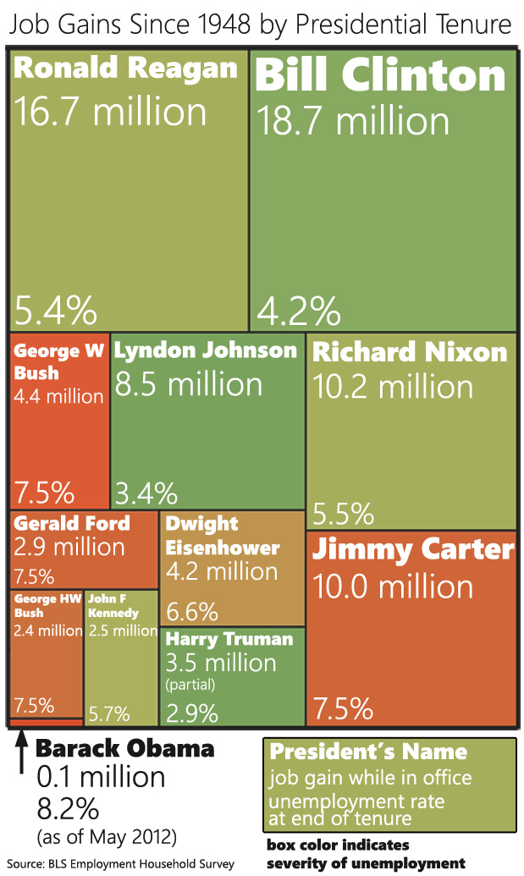

Slide 29
Matthias Shapiro
contact
@politicalmath
matthias.shapiro@gmail.com
http://politicalmathblog.com

